Slide 1
Analysis of Texas Death Row Inmates and Their Final Statements
By: Anthony Rodriguez

Slide 2



Presented By
Anthony Rodriguez
Data Analyst
Born & raised Texan
Tools Used
Excel, python, tableau
Contact info
tonyrodrigueztx@gmail.com
Linkedin.com/in/anthonyrod

Slide 3
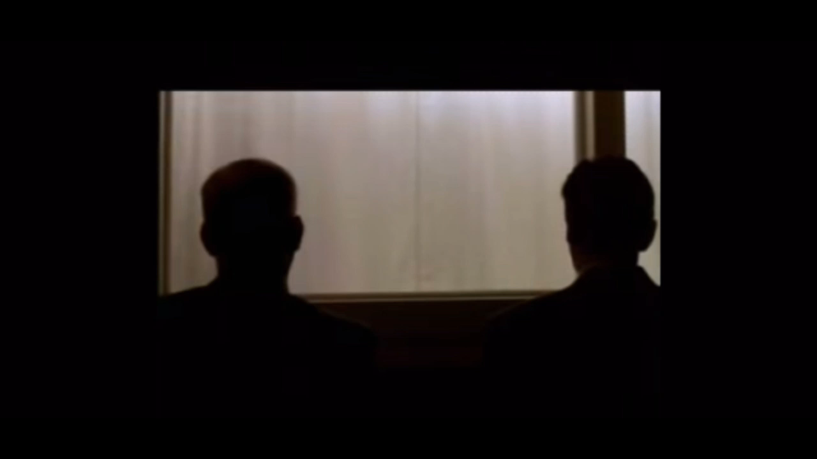
Notes:
1995 movie Dead Man Walking with Sean Penn / Susan Surandon

Slide 4
Objective
What is important to death row inmates in their final moments?
Compare Relationships vs Emotion
Apologetic over time
Does the final statement length correlate with words chosen?

Slide 5

Texas death row policy
There have been 544 executions in Texas from 1982 – 2017
Texas is responsible for a third of the united states capital punishments
Of the 254 Texas counties, 136 have never sent a single offender to death row
A person must be unanimously voted guilty by a jury to receive death penalty, as opposed to the 10 votes needed for a life sentence

Slide 6
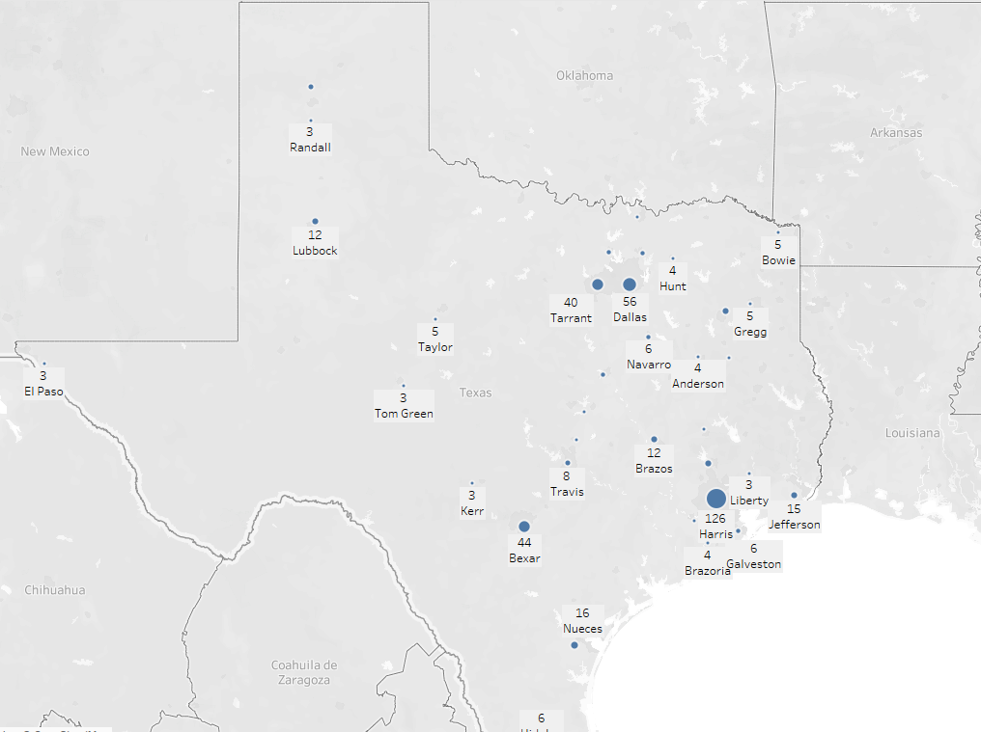
Texas county executions
1 Harris County (126)
2 Dallas County (56)
3 Bexar County (44)
4 Tarrant County (40)
5 Jefferson County (15)

Slide 7
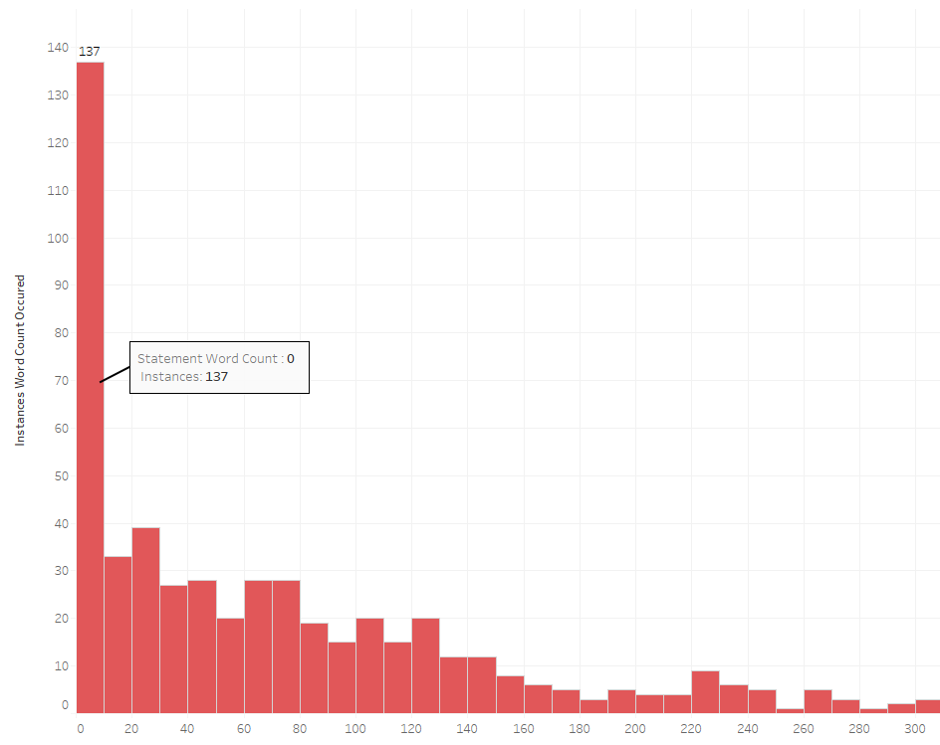
Statement Length Distribution
137 of the 544 inmates (25%) decided to give no statement at all.

Slide 8
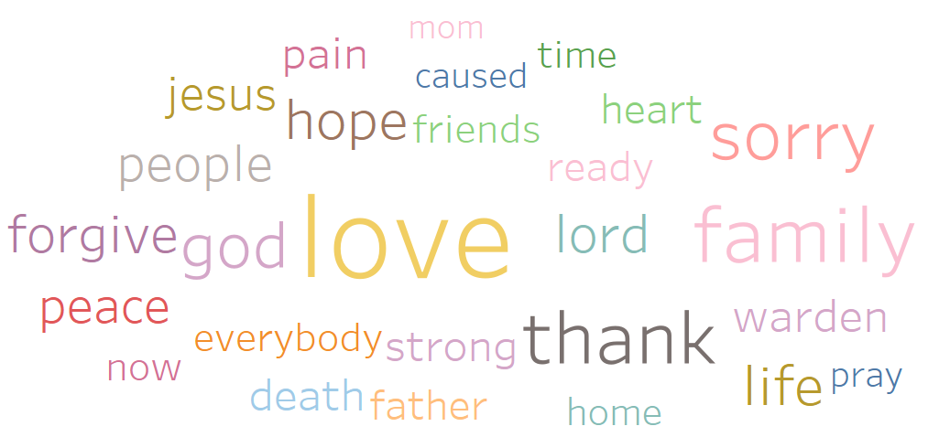
Most Used Words
Notes:
Word Cloud – bigger the font, the more the word is mentioned

Slide 9
Average statement length and people
Mothers - Most mentioned
Fathers – least mentioned, higher statement length
Notes:
Statement length can convey importance to the inmate. They are spending more time discussing the topics.

Slide 10
Statement length and emotion
Love – Most Mentioned
Innocent – least mentioned, higher Statement Length

Slide 11
relationship vs emotion
Notes:
Besides Love, Family is mentioned more than the most popular emotions. Could make the argument that the reason Love is mentioned so much is because they are talking about their family

Slide 12
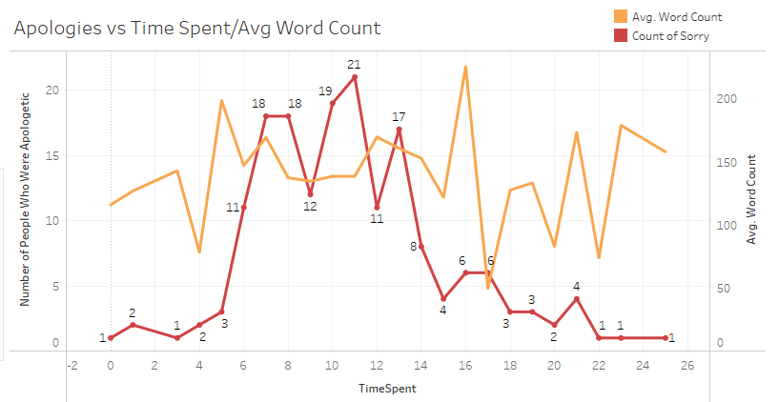
Notes:
Avg word count stayed in later years but the mentions of sorry. This could be that the further away they get away from the crime, the less they feel connected to the crime and the victims.

Slide 13
Statements over 400 words
Word Count | Innocent | God | Mother | Father | Sorry | Love | Family
1268 | ✓ |  | ✓ |  | ✓ | ✓ | ✓
748 |  | ✓ | ✓ |  | ✓ | ✓ | ✓
684 | ✓ |  | ✓ | ✓ |  | ✓ | ✓
533 |  | ✓ | ✓ | ✓ | ✓ | ✓
520 | ✓ | ✓ | ✓ | ✓ | ✓ | ✓ | ✓
510 |  | ✓ | ✓ | ✓ | ✓ | ✓ | ✓
482 |  | ✓ | ✓ | ✓ | ✓ | ✓ | ✓
478 |  | ✓ | ✓ | ✓ | ✓ | ✓ | ✓
447 |  | ✓ | ✓ | ✓ |  |  | ✓
443 |  | ✓ | ✓ |  | ✓ | ✓ | ✓
412 |  | ✓ | ✓ | ✓ | ✓ | ✓ | ✓
410 |  | ✓ | ✓ | ✓ | ✓ | ✓
406 | ✓ |  | ✓ |  | ✓
Totals | 3 of 13 | 10 of 13 | 13 of 13 | 9 of 13 | 10 of 13 | 11 of 13 | 10 of 13
Notes:
These are the statements over 400 words. These people took the most of their time to address the world and use the most keywords of the list.

Slide 14
In Conclusion…
‘father’ and ‘innocent’ were the least mentioned while also having the two highest words per statement
inmates choose Relationships over emotion
People who spent between 5 to 14 years in jail were more apologetic
Longer the statement, more keywords used
Age and Education did not have an impact on statement length or words chosen
Notes:
For the most part, the criminals are male so the mentioning of there fathers has some importance to these inmates.
Age and Education did not have an effect on statement length
father’ and ‘innocent’ were the least mentioned of the sampled keywords while also having the two highest words per statement
People did seem to be more apologetic for their crimes as they spent more time in jail, mostly between 5 to 14 years. But as time went on, the apologies were less frequent which could be due to the affects of being incarcerated.

Slide 15

Thank you for your attention today
Questions?

